Slide 1
BART_2023
File created on: 02/04/24 6:56:39 pm GMT-7

Slide 2
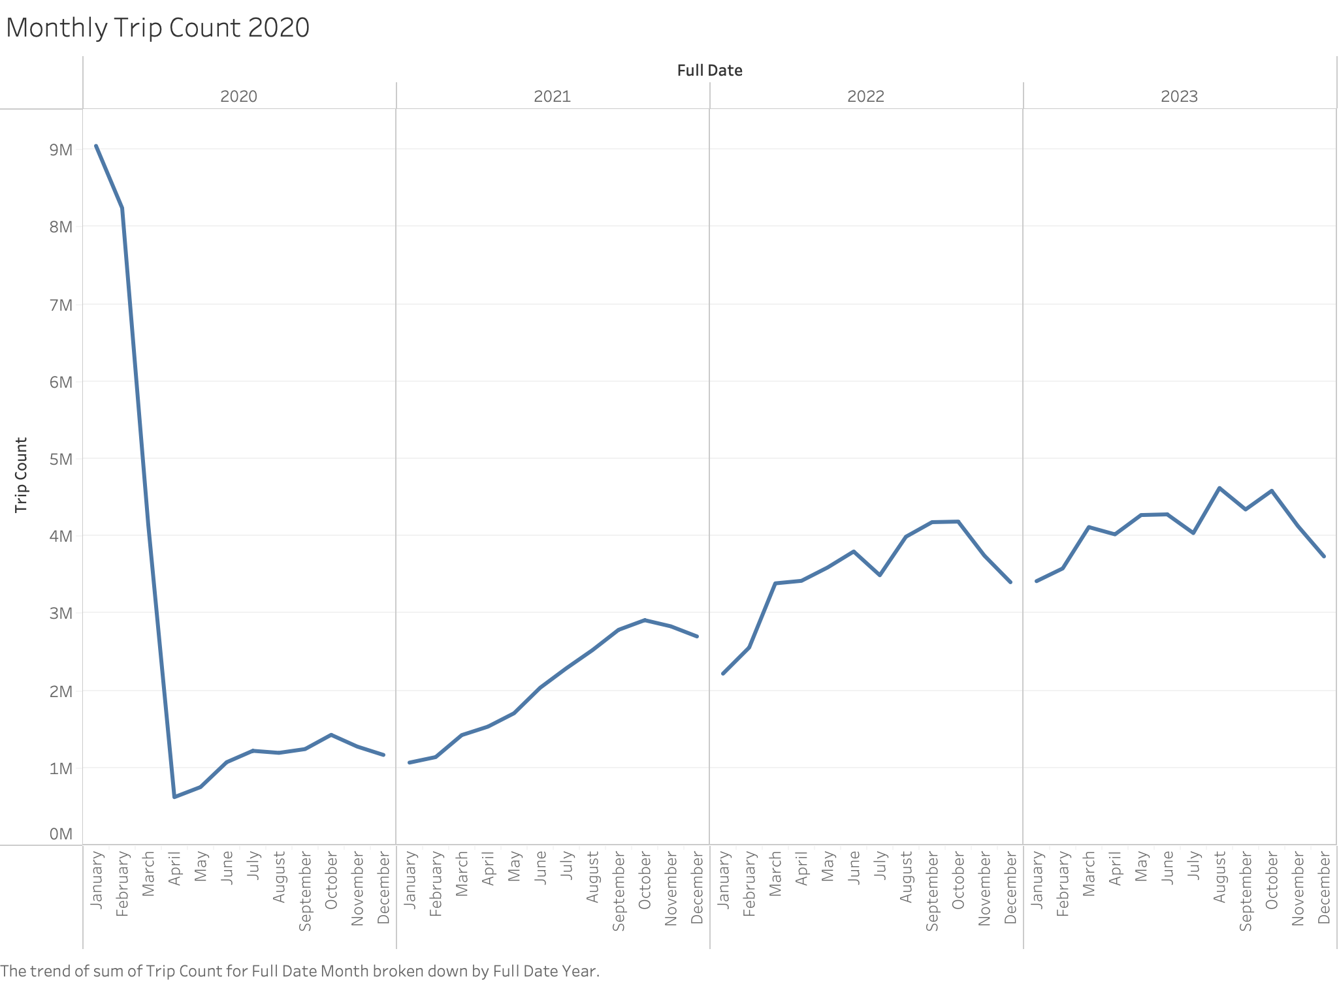

Slide 3
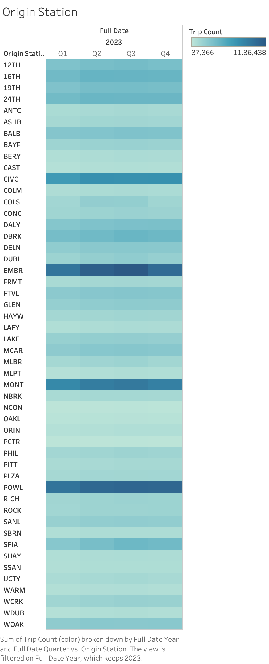

Slide 4
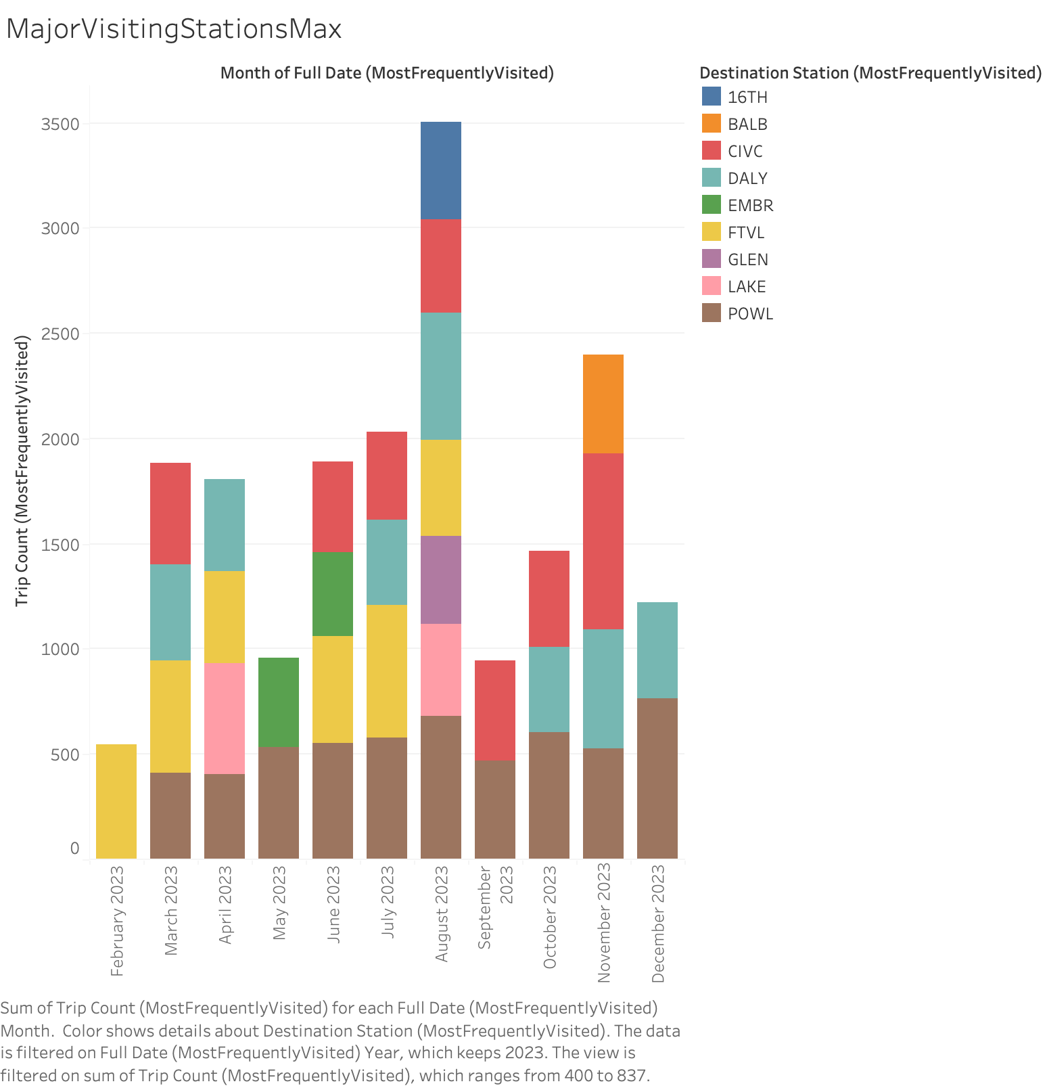

Slide 5
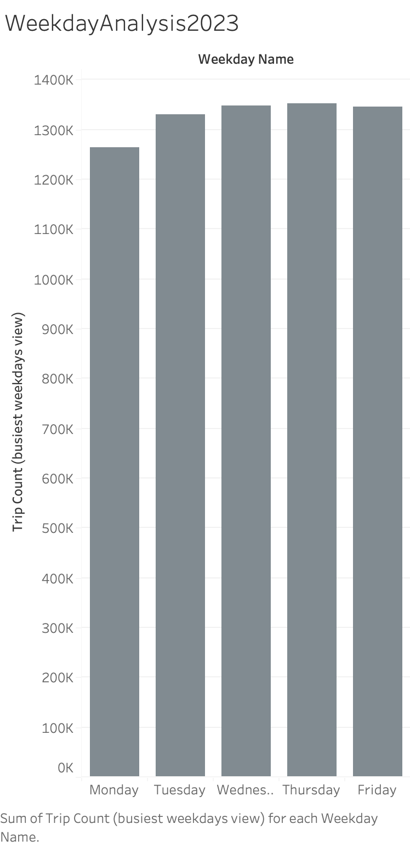

Slide 6
